Slide 1
Potential Concepts
Team 1: Shruti, Rachana, Mihir, William, Patrick

Slide 2
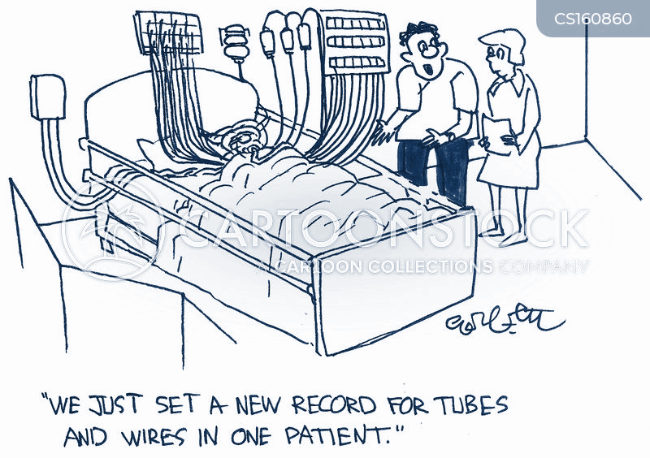
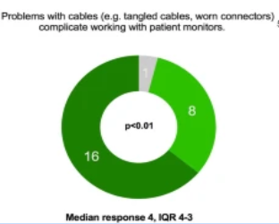
PROBLEM : Inconvenient Health Care
Inconvenient, limited real-time monitoring, time consuming and overreliance on wired system.
PROBLEM MAGNITUDE
According to 2019 research of 120 anesthesiologists found that 24% of them preferred wireless solutions in response to issues such as long cables, tangled or broken plugs, and unplugged cords.
Concept A : Biobloom
Improving healthcare through technology
1
2
Current Process and Technology
Healthcare facilities depend on wired monitoring systems that involve bedside monitors, wired sensors, and centralized monitoring stations to track patients' vital signs and health parameters.
What is missing and current technology
Limited Mobility
Real-Time Monitoring
Scalability
Remote Monitoring
How is solution game changer
The strategy we recommend entails establishing wireless healthcare monitoring systems and wearable monitors, which have several advantages such as improved mobility, real-time data analysis, flexibility, and distant monitoring.
Slide by Shruti

Slide 3

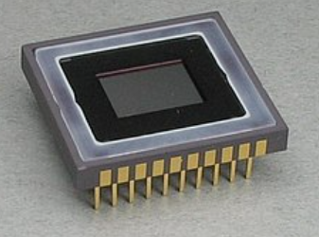
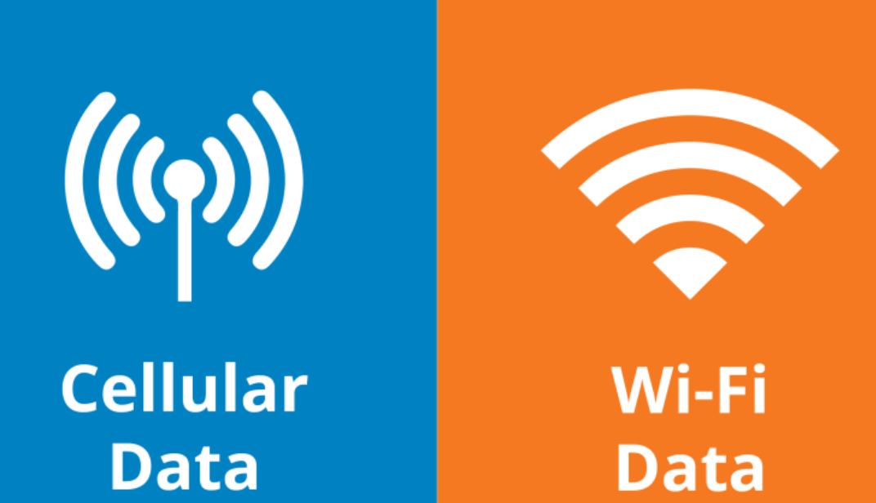
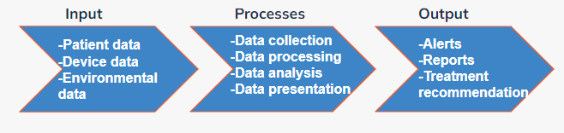
Architecture
3
4
5
Attribute | Description
Form | Smart Patches/Smart Clothing - Embedded sensors for vital signs, breathable design, washable and durable materials Wearable Monitors - Integrated rechargeable batteries, Sleek and lightweight with real-time data display and adjustable straps.
Fit (Size is variable) | Integration of Wireless Technologies - Bluetooth for short-range communication, Wifi for cloud connectivity, Cellular networks for remote monitoring. Data Transmission and Fusion - LPWAN for communication, Zigbee for mesh networking, RFID, and NFC for secure identification.
Function | Data Collection, Processing, and Analysis - Real-time data gathering from embedded sensors, Cloud-based platform for data processing, and Machine learning for predictive analytics. User Interface, Security, and Compliance- User-friendly display on wearable monitors, Mobile app/web portal, Robust encryption, Compliance with healthcare regulations for patient privacy
How it works :
Slide by Shruti & Rachana

Slide 4
Infrastructure
People
Healthcare professionals
IT technicians
Hardware
Wearable medical devices such as sensors and controllers
Gateway and networking equipments like Wifi and routers.
Software
Embedded software
Communication protocols
Monitoring software
Data management software.
Tooling & Equipment
Testing equipment
Diagnostic equipment
Programming tools
Wireless network tools
Data Analysis tools
Security tools
Documentation
User manuals
Technical specifications
Regulatory documentation
Installation guides.
Facilities
Testing facilities
Data center facilities
Training facilities
Slide by Rachana

Slide 5
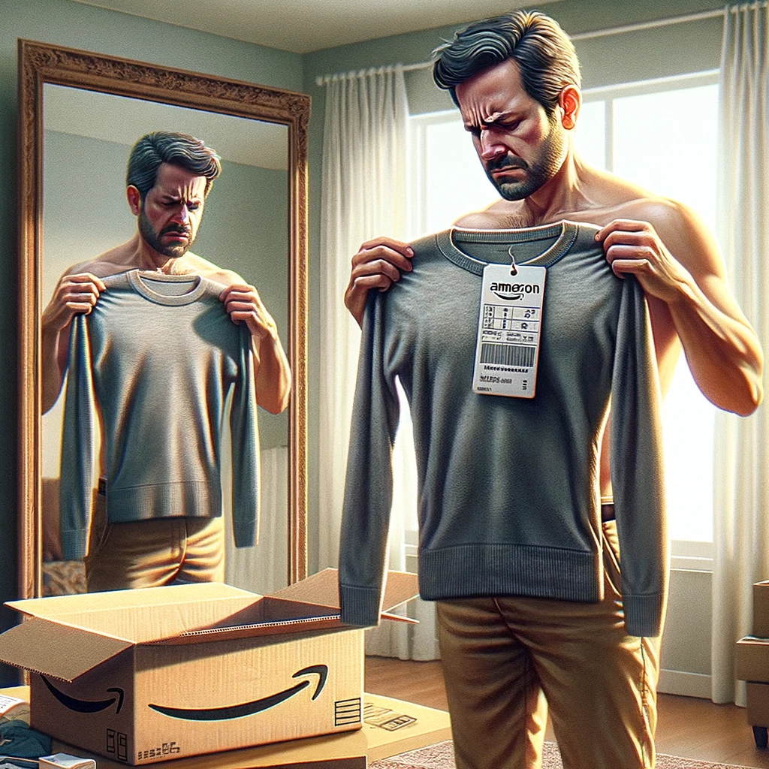
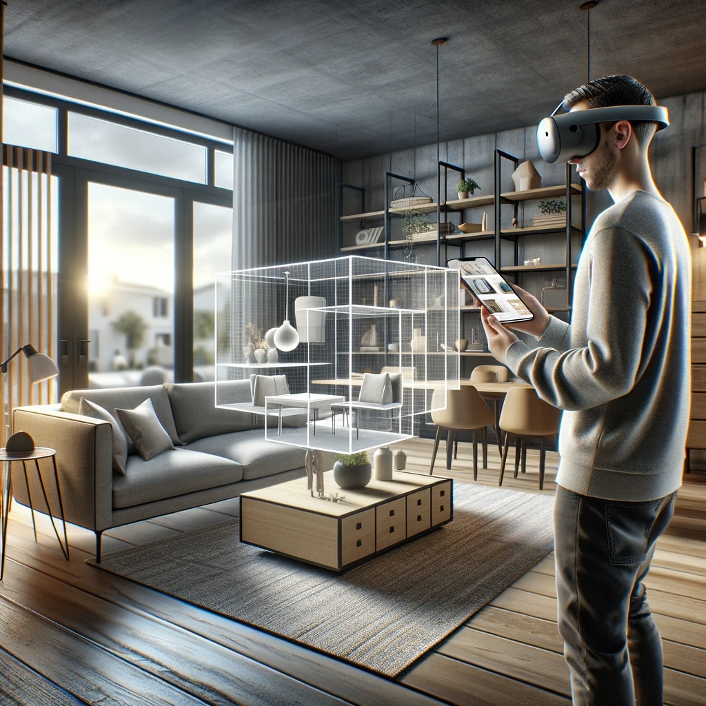
Slide by Mihir Kavishwar

Slide 6

PROBLEM : Outdated online shopping.
Inconvenient, time consuming, inefficient 2D visualization for online shopping experience.
PROBLEM MAGNITUDE
70% of clothing is returned due to fit and color mismatch!⁸ Each year, US companies spend ~$50 billion on product returns. These goods are the cause of 27 million tons of CO2 emissions each year!⁹
Concept B : InfiniShop
Virtual Showroom experience with AR shopping.
Current Process and Technology
E-Commerce Platforms: Facilitate personalization.
Mobile Shopping: Shopping on phones, through ads.
Payment Security: This tech ensures the experience is secure.
What is missing and current technology
AI & Personalization: Needs deeper AI integration for better recs.
AR/VR: Lack of better immersive shopping experiences.
Sustainability & Delivery: Enhancements in supply chain transparency and faster delivery.
Game changer
AR/VR: We will give full AR experience for shopping. People can see the product in actual dimensions in real time.
AI & Personalization: Personal talking assistants which will know your nuances and tailor your experience everytime you shop.
Slide by Mihir Kavishwar

Slide 7
Architecture
 | Description
Form | AR Application Software: User-friendly application accessible via the Apple Vision Pro headset.
Fit (Variable) | Source code which resides on the cloud, the shopping items size is variables. Since, its a software dimensions will be not relevant.
Function | AR Shopping, AI and ML for personalization and recommendations. Secure database for payment.
Process
Take input from the available Headset Sensors, take input dimensions of the shopping items and present it based on user preferences.
Output
The output of our product will be 3D visual in space of what the user would like to “try on”.
Input
AR/VR headset like the vision pro.
User account.
Strong Internet.
Slide by Mihir Kavishwar

Slide 8
Infrastructure
People
AR/VR developers
AI/ML engineers
UX/UI designers
Hardware
Apple Vision Pro headset (for user)
Data servers
Software
APIs for AR/VR
Cloud computing
Database management
Tooling & Equipment
Development kits for Apple Vision Pro
AR/VR content creation tools
Machine learning frameworks
Documentation
Comprehensive guides for users, developers, and retailers
API documentation
Regulatory documentation
Privacy policies
Facilities
Data centers or cloud services
Office space
Slide by William Lopez

Slide 9

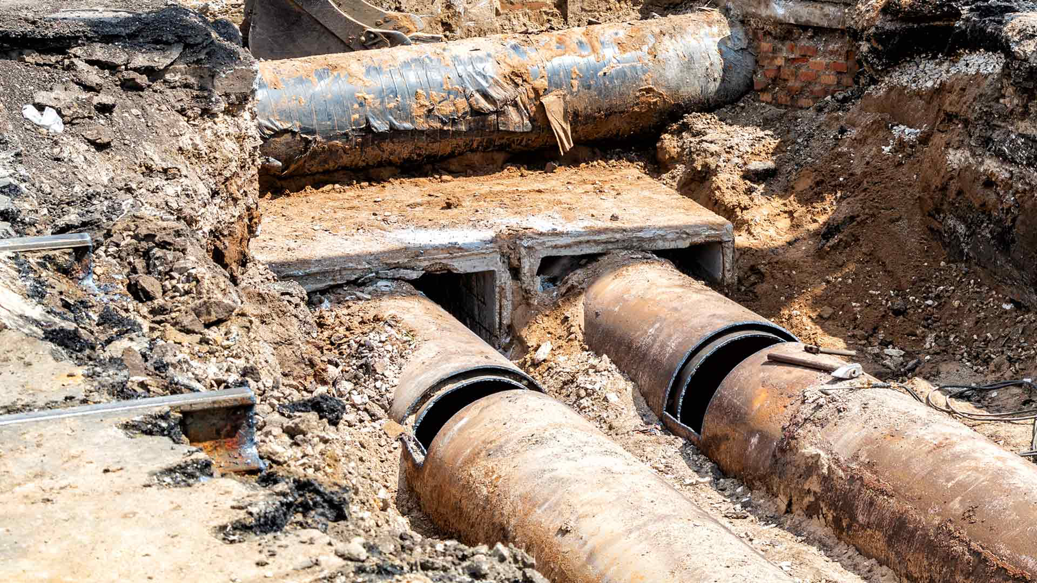
PROBLEM : Water Sanitation and Supply
Management
Contamination: aging infrastructure, human activities such as illegal dumping and sewage spills
PROBLEM MAGNITUDE
In 2021, reported violations involving water treatment rules were responsible for exceeding health-based standards for 15.6 million people
Concept C : AquaChain
Blockchain water sanitation and supply management
6
7
Current Process and Technology
EPA, the states, tribes, public water systems, and certified laboratories
Samples are collected
Steps are taken to remove or prevent contamination and consumers are notified
What is Missing and Current Technology
Real-Time Monitoring
Scalability
Remote Monitoring
Regulatory Structure
How is Solution Game Changer
AquaChain will facilitate better decision-making, promote sustainable water usage, and improve access to clean water, making it a significant innovation in the water sector
Slide by Patrick Okimi
Notes:
Blockchain is a digital record keeping system spread across many computers

Slide 10


Architecture
 | Description
Form | Blockchain network composed of smart sensors that feed into automated contracts
Fit | Sensors integrated along process flows in community water supply systems. Computers hosted at data centers with data analytics module tools to analyze blockchain-stored data.
Function | IOT integrated sensors will monitor water supply data such as quality, pipe pressure, and water usage on the blockchain network where the data is accessible to all stakeholders
Input
Community water supply systems
Process
Sensors collect water data and send data to be analyzed within blockchain network
Output
Water quality and supply issue resolvements
Slide by Patrick Okimi

Slide 11
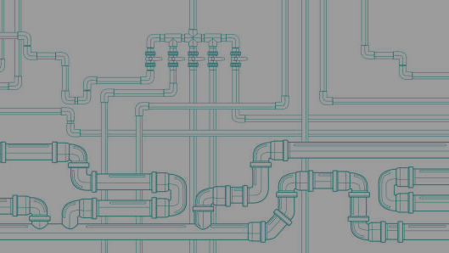
Infrastructure
Hardware
IOT
Sensors
Computers
People
Blockchain developers
Data Analysts
Project managers
Water management personnel
Software
Blockchain
Platform data analytics
User interface (UI)
Tooling & Equipment
IOT device development kits
Blockchain development environments
Documentation
System set up guides
Stakeholder usage guides
Smart contract definitions
Data interpretations
Facilities
Data hosting centers
Management & monitoring centers
Slide by Patrick Okimi

Slide 12
References
https://www.cartoonstock.com/cartoon?searchID=CS160860
https://bmcanesthesiol.biomedcentral.com/articles/10.1186/s12871-019-0757-z
https://www.onthemosway.eu/rfid-technology-and-e-seal-facilitating-the-port-logistics-automation-and-cargo-tracking/
https://simple.wikipedia.org/wiki/Sensor
https://www.optconnect.com/blog-post/whats-the-difference-between-wi-fi-and-cellular-connectivity
https://carewater.solutions/en/waterborne-diseases/
https://www.bv.com/perspectives/aging-infrastructure-and-workforce-vexing-challenges-remain/
https://www2.deloitte.com/us/en/insights/topics/emerging-technologies/augmented-shopping-3d-technology-retail.html
https://www.theguardian.com/global-development/2023/mar/31/what-happens-when-we-send-back-unwanted-clothes

